Slide 1

Final project presentation:
Berlin, 09.08.2022
Stephanie Fosso
& Weiling Peng
How popular will your video be on YouTube?
1 of 10
www.wbscodingschool.com

Slide 2
problems
solution
CHALLENGES
Agenda
2 of 10
www.wbscodingschool.com

Slide 3


A data-solution-based project for – Miguel
Miguel has 2 problems
Want to get videos popular/trended
Spend hours every day to read comments from audience
3 of 10
www.wbscodingschool.com

Slide 4
problems
solution
CHALLENGES
Agenda
4 of 10
www.wbscodingschool.com

Slide 5

Big data shows a better channels
–
Pets & Animals
New positioning channel
Current channel
5 of 10
www.wbscodingschool.com

Slide 6
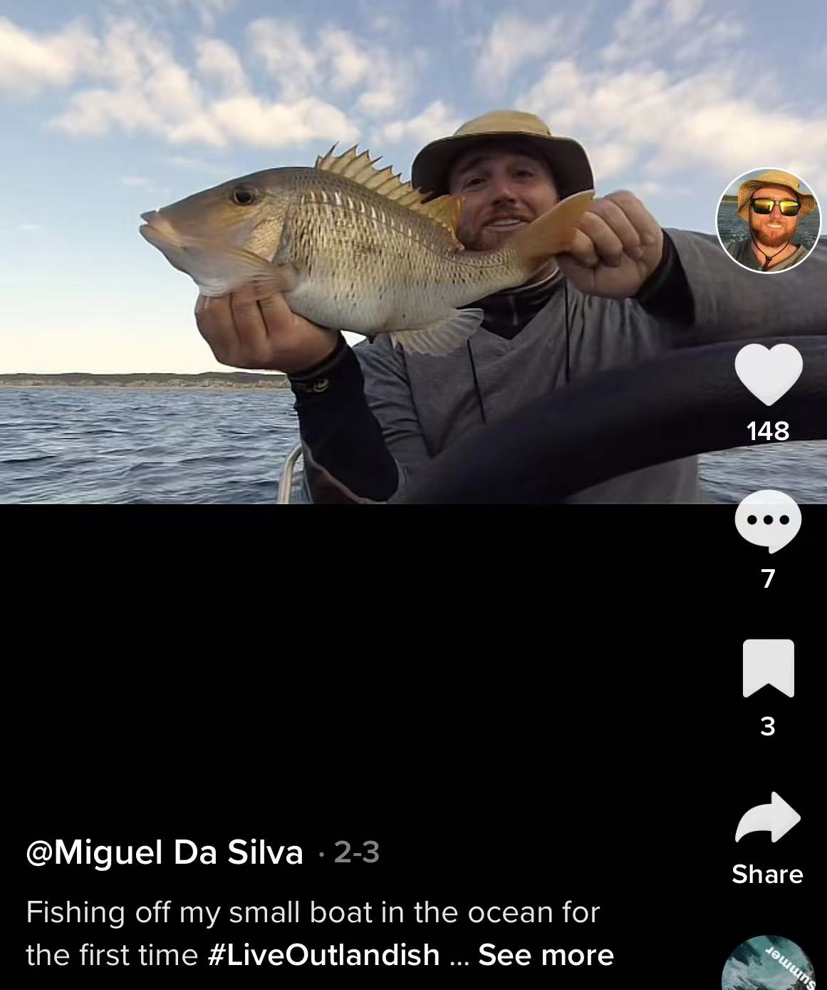

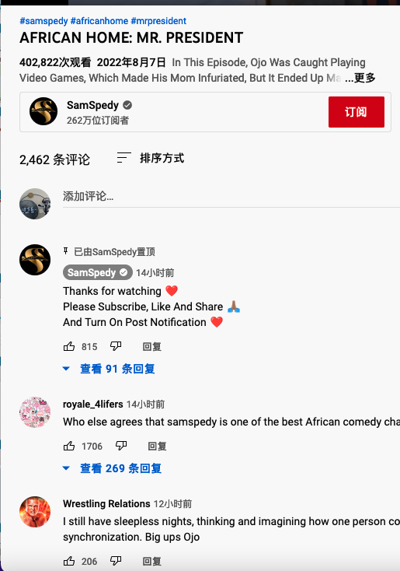
Before posting videos -
Check the trending probability
Title
Chance to be popular
is
84% : )
Tag
Description
channel
category
6 of 10
www.wbscodingschool.com

Slide 7
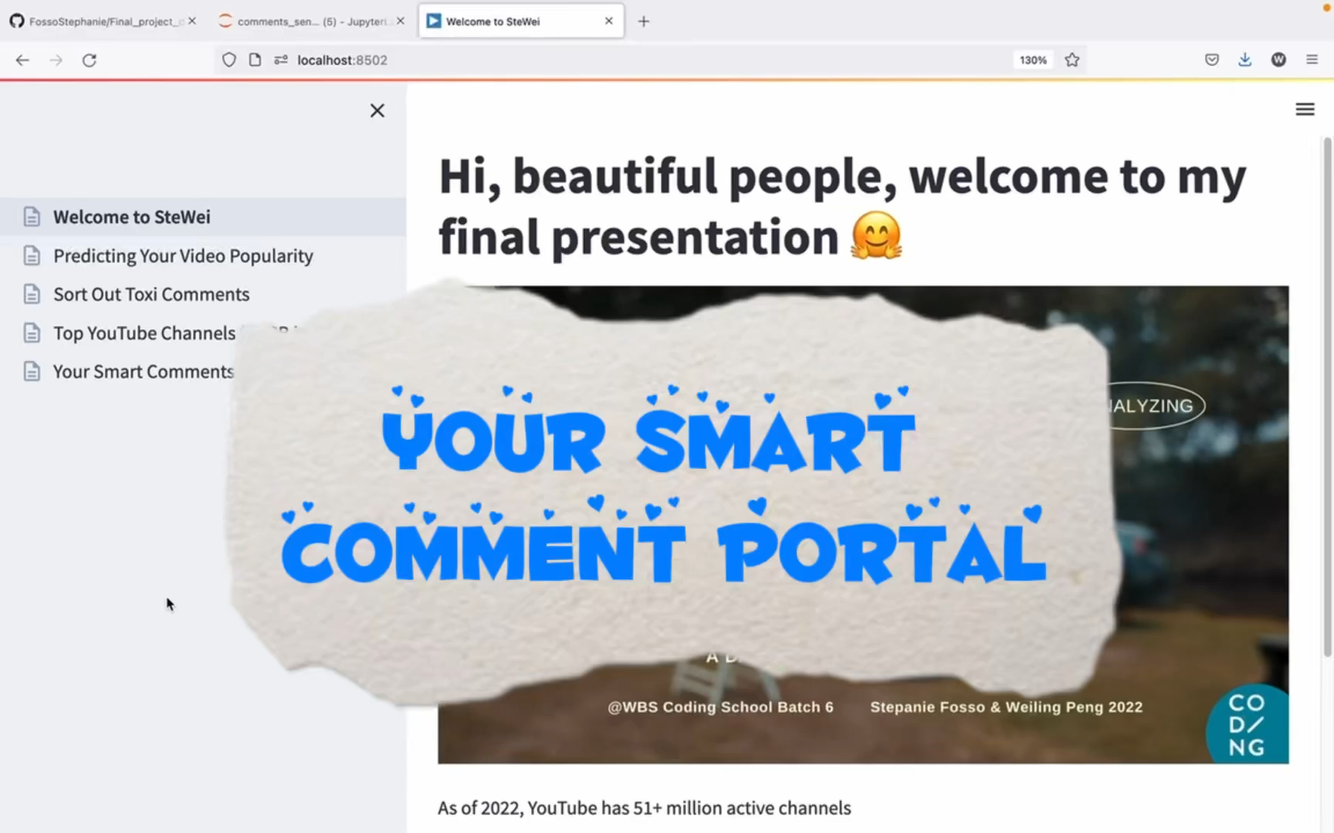
Read your comments in
an efficient way
- Saving time & emotions
7 of 10
www.wbscodingschool.com

Slide 8
Fill Spam Comments Out
-
Focus on Real Opinions
8 of 10
www.wbscodingschool.com

Slide 9
problems
solution
CHALLENGES
Agenda
9 of 10
www.wbscodingschool.com

Slide 10

Keeping an Eye on Trends is Crucial in the Digital World
New algorithm : we need to always keep an eye on market changes
External factors : keep topical interests, how your competition is performing,
create relevancy to the current season
……..
10 of 10
www.wbscodingschool.com

Slide 11

Thank you
&
happy Youtubing : )
11 of 10
www.wbscodingschool.com

